Slide 1

Find the Influential Node of a Dynamic Graph
Ranojoy Barua (510515025)
Ankita Choudhary (510515058)
Rounak Mazumder (510515014)
Aniket Sarkar (510515066)
Guided by : Prof. Susanta Chakraborty

Slide 2
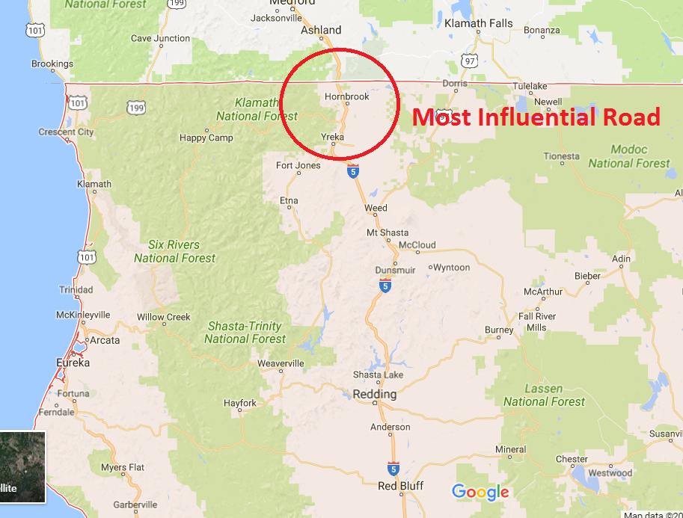
Introduction
Problem in present techniques of finding most influential nodes are they focus on the parameters which are instantaneous in nature they don’t take the total network at once.
This project aims to take the total road network at once and divide it in small networks and to identify the most important / influential / critical points in the total road network for movement of the traffic.

Slide 3
Motivation
Due to urbanization huge number of cities are coming up with a large road network.
Represent the total road network on graph.
To reduce the time for travelling in the city.
To find the alternate routes.
Find the most influential road in a given city (graph) for smooth movement of traffic in the whole city.

Slide 4
Objective
Representing a graph in edge list.
Clustering the total road network using K-Mean algorithm.
Find most influential road in each cluster by calculating parameters:
1) Freeman’s degree centrality
2) CC value
3) Enhanced degree centrality

Slide 5
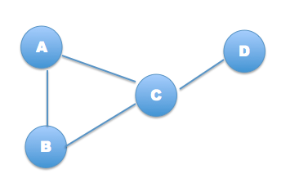
Preliminary
Representing a graphs by using edge list.
A | B | C
B | A | C
C | A | B | D
D | C

Slide 6
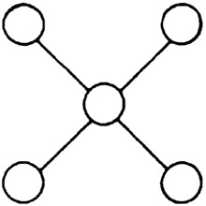
Preliminary
Influential node : Node that is well connected through out the graph.
Node in the center is
the most influential node.

Slide 7
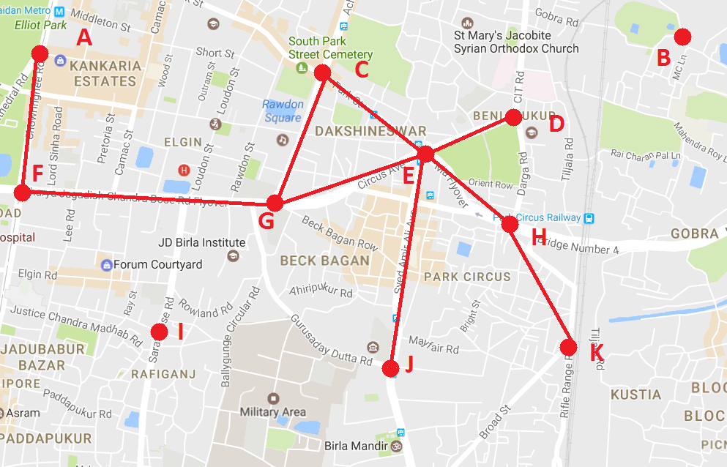
Road Network
Road network
Red spots denotes the junctions.
Each junction is given an unique ID.
Pair of these ID denotes an road. E.g., (A,F) (G,E) etc.

Slide 8
Road Network Clustering
Breaking down the whole road network in small parts.
Clustering is done to divide the total dataset into small sub-parts.
K-Mean clustering is used.
K-means clustering aim to partition n observations into k clusters.
Each point belongs to the cluster with the nearest mean.

Slide 9
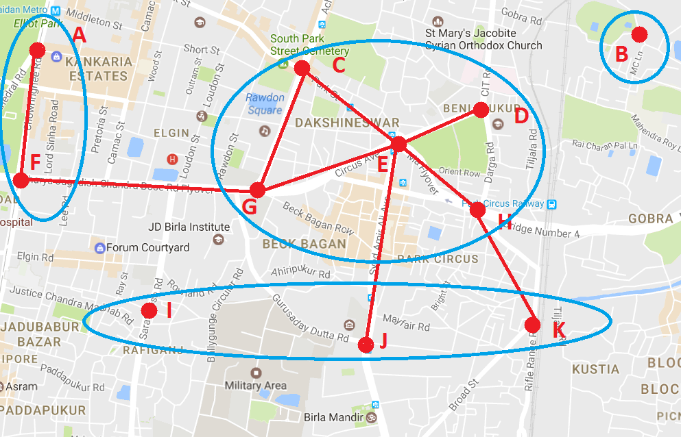
Road Network Clustering
Clustered Road Network

Slide 10
Road Network Clustering
Steps for K-Mean clustering :
a) Select randomly K-points.
b) Calculate distance (Euclidian) distance of each point with K centers and assign to the cluster with minimum distance.
c) Recalculate the centers of all clusters by taking average of each vectors.
d) Redo step b and c till the members of clusters keeps changing.

Slide 11
Clustering Example
Serial Number | X-axis | Y-axis
A | 1 | 2
B | 2 | 3
C | 7 | 8
D | 8 | 6
E | 9 | 10
Let these are the data points to be clustered.
Serial Number | X-axis | Y-axis
C1 | 2 | 3
C2 | 7 | 8
Randomly selected points for K = 2

Slide 12
Clustering Example
Calculation :
c1 - a) root(square(2-1) + square(3-2)) = root(1+1) = root(2)
c1 - d) root(square(2-8) + square(3-6)) = root(36+9) = root(45)
c1 - e) root(square(2-9) + square(3-10)) = root(49+49) = root(98)
c2 - a) root(square(7-1) + square(8-1)) = root(36+49) = root(85)
c2 - d) root(square(7-8) + square(8-6)) = root(1+2) = root(3)
c2 - e) root(square(7-9) + square(8-10)) = root(4+4) = root(8)
(c1 - a) < (c2 - a)
(c1 - d) > (c2 - d)
(c1 - e) > (c2 - e)
So, point (a) assigned to (c1)
and point (d) and (e) assigned to (c2)

Slide 13
Clustering Example
In iteration 1:
c1) (2,3) and (1,2)
c2) (7,8) , (8,6) and (9,10)
Now recalculate the centers:
c1) x:[(2+1)/(2)] = 1.5 y:[(3+2)/(2)] = 2.5
c2) x:[(7+8+9)/(3)] = 8 y:[(8+6+10)/(3)] = 8
Co-ordinate for center:
c1) (1.5 , 2.5)
c2) (8.0 , 8.0)

Slide 14
Clustering Example
Re-do the calculation of Euclidian distance:
c1 - a) root(square(1.5-1) + square(2.5-2)) = root(0.25+0.25) = root(0.50)
c1 - b) root(square(1.5-2) + square(2.5-3)) = root(0.25+0.25) = root(0.50)
c1 - c) root(square(1.5-7) + square(2.5-8)) = root(30.25+30.25) = root(60.50)
c1 - d) root(square(1.5-8) + square(2.5-6)) = root(42.25+12.25) = root(54.5)
c1 - e) root(square(1.5-9) + square(2.5-10)) = root(56.25+56.25) = root(112.5)
c2 - a) root(square(8-1) + square(8-2)) = root(49+36) = root(85)
c2 - b) root(square(8-2) + square(8-3)) = root(36+25) = root(61)
c2 - c) root(square(8-7) + square(8-8)) = root(1+0) = root(1)
c2 - d) root(square(8-8) + square(8-6)) = root(0+4) = root(4)
c2 - e) root(square(8-9) + square(8-10)) = root(1+4) = root(4)

Slide 15
Clustering Example
(c1 - a) < (c2 - a)
(c1 - b) < (c2 - b)
(c1 - c) > (c2 - c)
(c1 - d) > (c2 - d)
(c1 - e) > (c2 - e)
So points (a) and (b) is assigned to (c1)
and points (c) , (d) and (e) is assigned to (c2)
Now as we can see that the points to the cluster are same as the previous.
So we terminate the clustering at this point.

Slide 16
Calculated Parameters
Now we find the most influential node in each of the clusters.
Various parameters are calculated to find the most influential node. They are :
a) Freeman’s Degree Centrality : Denotes how many locations can be visited from a location.
b) Clustering Coefficient : Denotes how much the neighboring roads are connected among each other.
c) Enhanced Degree Centrality : Denotes how much a road is connected to the whole city.

Slide 17
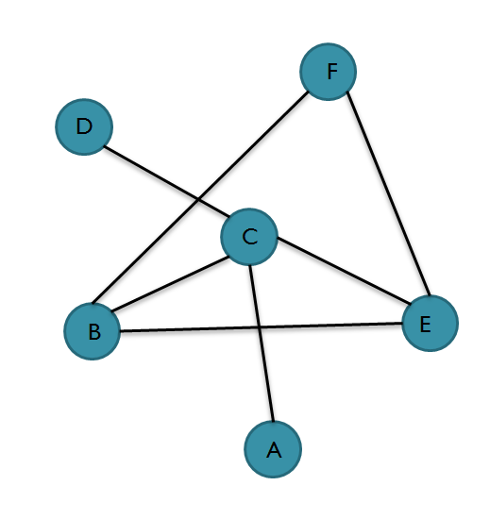
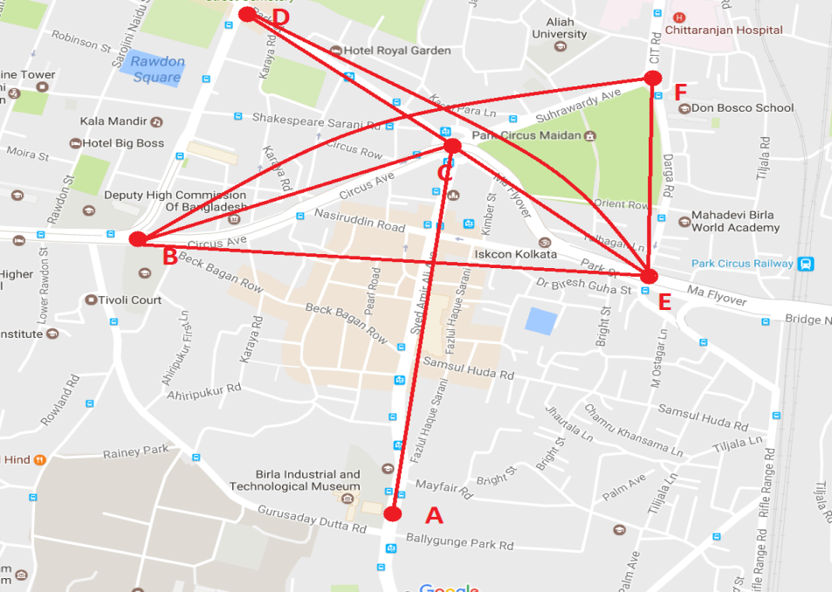
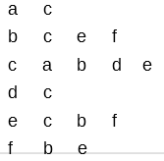
Road Network Presentation
Road Network
Graph Representation of
road network
Edge-list representation

Slide 18
Road Network Analysis
(CC Value)[1]
Total number of edges among neighbors is divided by the possible number of edges in between the neighbors.
e.g. In this graph we find the CC value of node b

Slide 19
Road Network Analysis
(CC Value)
Select neighbors for node b.
i.e., c e f
Check all the possible edges that may exist in between the neighbors of node-b i.e., check does edge
c-e, c-f, e-c, e-f, f-c and f-e
exist and if exist count how many of them exist.

Slide 20
Road Network Analysis
(CC Value)
For node-b only c-e, e-c, e-f and f-e exist i.e., 4 edges.
Divide this number by 2 as edge A-B is equal to edge B-A.
Total possible edges between neighbours is calculate using formula
total_possible_edges = n*(n-1) / 2
For node-b total possible edges is 3*(3-1)/2 which is equal to 3.
So CC value for node-b is 2/3 = 0.667 i.e.,
(total_edges_exist_among_neighbours / total_possible_edges_among_neighbours)

Slide 21

Road Network Analysis
(Freeman’s Degree Centrality)[2]
For node-x total difference between degree of node-x and the degree of neighboring nodes is divided by total difference between degree of node with maximum degree and all of the neighboring nodes of node-x.
i.e.

Slide 22
Road Network Analysis
(Freeman’s Degree Centrality)
Node with maximum degree is node-c i.e., 4.
To find freeman’s degree centrality of node-b first select the neighbors of node b
i.e., c e f
Now to calculate the value of numerator (a) find sum of all the difference between degree of node-b and neighboring nodes of b i.e.,( c, e, f )

Slide 23
Road Network Analysis
(Freeman’s Degree Centrality)
Degree of c, e and f are 4, 3 and 2 respectively.
So, a = |(3-4)| + |(3-3)| + |(3-2)| = 2
Similarly to calculate the value of denominator (b) find sum of all the difference between maximum degree of node in graph and neighboring nodes of b i.e.,( c, e, f )
As node-c have maximum degree i.e., 4
So b = |(4-4)| + |(4-3)| + |(4-2)| = 3
So freeman’s degree centrality of node-b is 2/3 = 0.667

Slide 24
Road Network Analysis
(Enhanced Degree Centrality)[3]
Enhanced degree centrality of a node is calculated by multiplying the CC value and freeman’s degree centrality of a node.
To find the enhanced degree centrality of node b in this graph first CC and freeman’s degree centrality is calculated and then multiplied.
So, enhanced degree centrality of node b is :
0.667*0.667 = 0.447
As CC value of node-b = 0.667
Freeman’s degree centrality of node-b = 0.667

Slide 25
Road Network Analysis
Selection Procedure for Most Influential Node
Aggregate sum of ranks :
If two or more nodes share the least ranking then all of them are the most influential node because their orientation, connectivity in the graph and connectivity among the neighbors is identical.
The influential node of the whole network represents the most important place or junction of the city or state.
Now we plot the obtained result of 4 clusters in map.
Total
Node number | Total Rank
1 | 14
2 | 16
3 | 15
4 | 12
5 | 18
6 | 9
Total (Sorted based on rank)
Node number | Total Rank
6 | 9
4 | 12
1 | 14
3 | 15
2 | 16
5 | 18

Slide 26
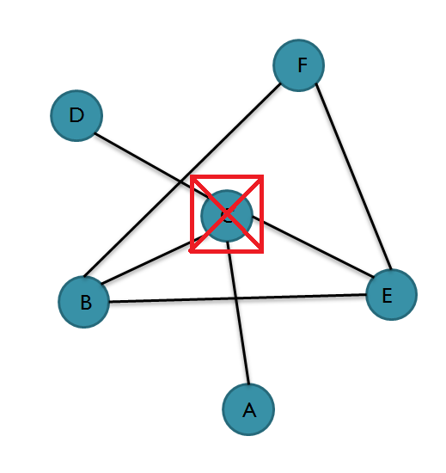
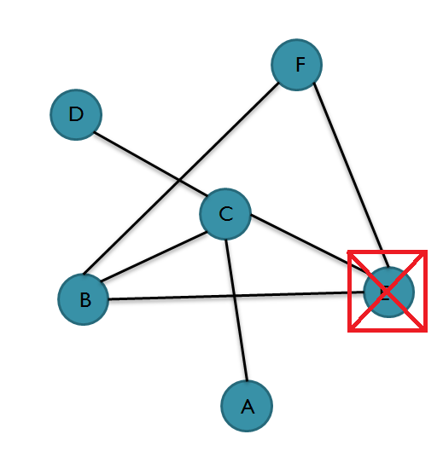
Road Network Analysis
Most Influential Node
If node C is deleted then nodes
A and D can’t be reached
If node E is deleted then also
all the nodes can be accessed

Slide 27
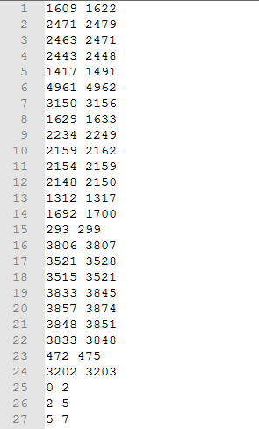
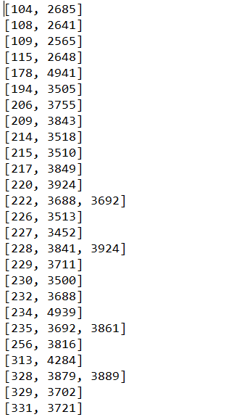
Experimental Result
Representing the data set in edge list.[4]
Road Network Data
(Source , Destination)
Each place is represented as nodes
Each road is represented as edges.
Edge List Representation of Road Network Data

Slide 28
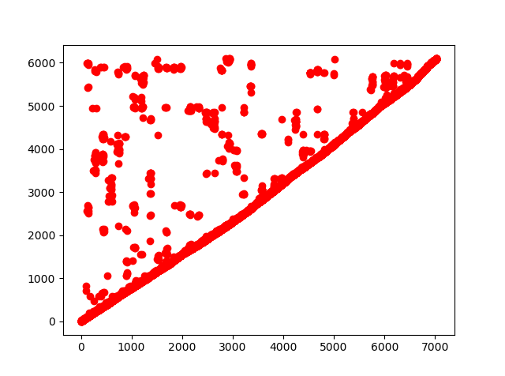
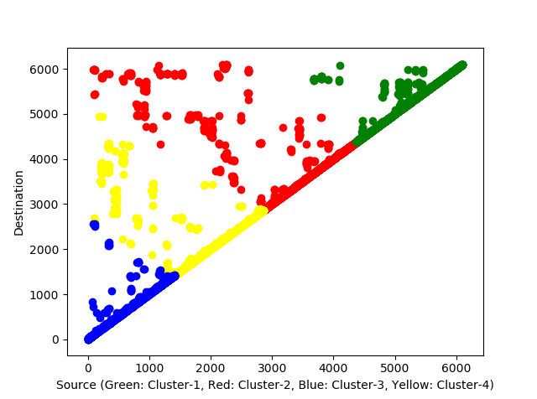
Experimental Result
Graphical visualization of clustering the road network.[4]
Original Data
Clustered Data
Cluster centers :
[ 3328.32429559 3836.22647528]
[ 2000.1452164 2216.73861048]
[ 705.61107654 738.50777847]
[ 5181.33650084 5232.98882057]

Slide 29
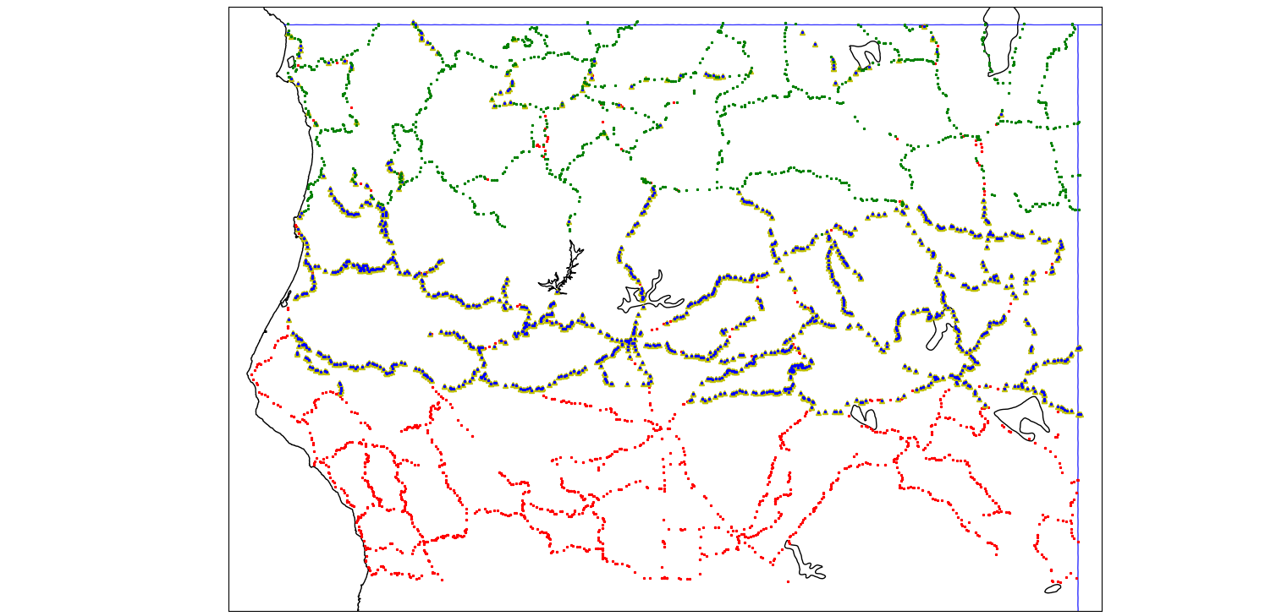
Experimental Result
Visualization of Clustered Road Network[4]
Cluster-1 denoted by Color Red
Cluster-2 denoted by Color Blue
Cluster-3 denoted by Color Green

Slide 30
Experimental Result
Serial Number | Description | Latitude (Most-Influential node) | Longitude (Most-Influential node) | Degree Centrality | Clustering Coefficient | Enhanced Degree Centrality
1 | Total dataset | 41.907001 | -122.520287 | 0.0 | 0.0 | 0.0
2 | Cluster-1 | 39.500763 | -121.531273 | 0.0 | 0.0 | 0.0
3 | Cluster-2 | 40.351158 | -123.939072 | 0.0 | 0.0 | 0.0
4 | Cluster-3 | 41.907001 | -122.520287 | 0.0 | 0.0 | 0.0
5 | Cluster-4 | 41.15773 | -121.031357 | 0.0 | 0.0 | 0.0

Slide 31
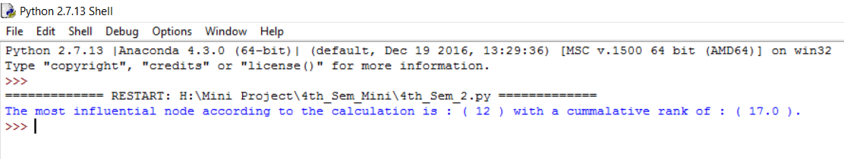
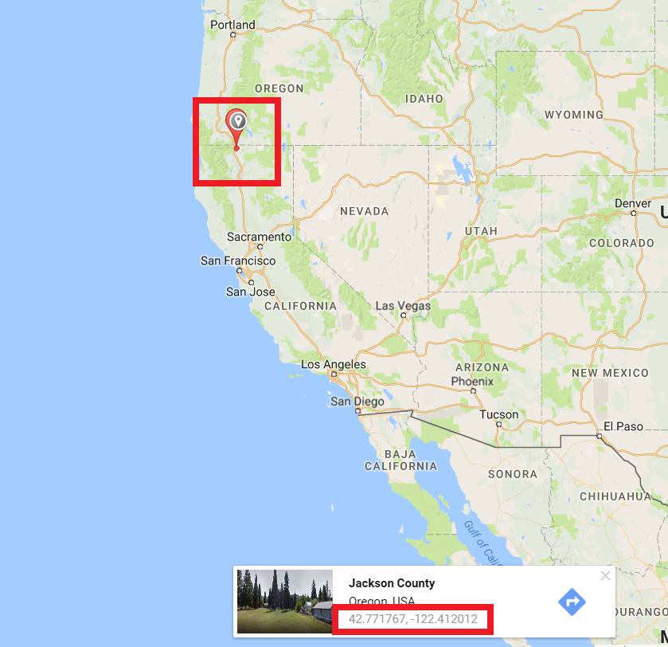
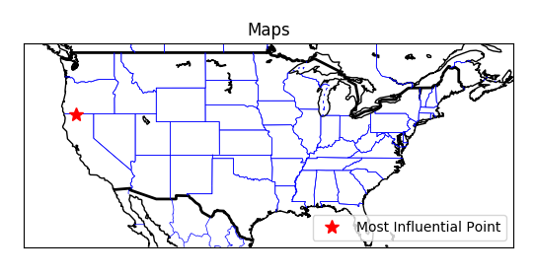
Most Influential Node
Output obtained on total road network:
Plot in map :

Slide 32
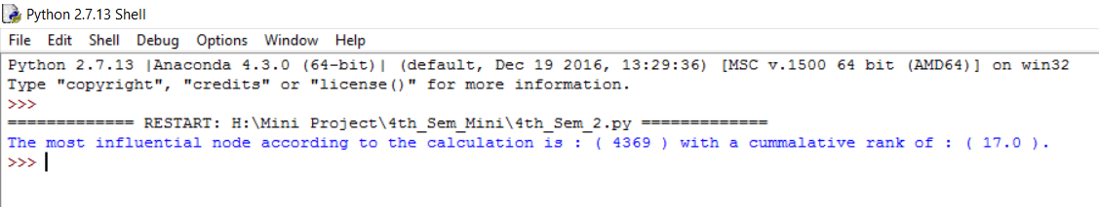
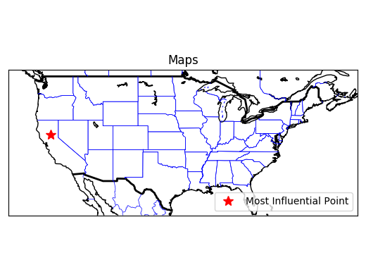
Most Influential Node
Output obtained on Cluster-1:
Plot in world-map :

Slide 33
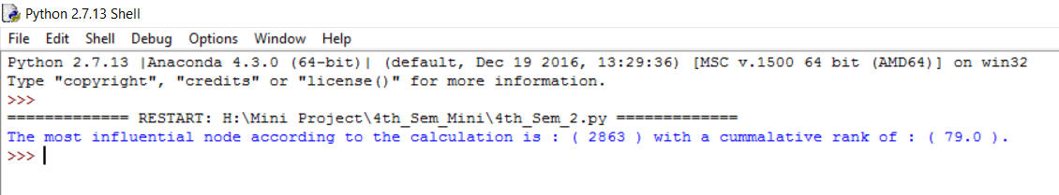
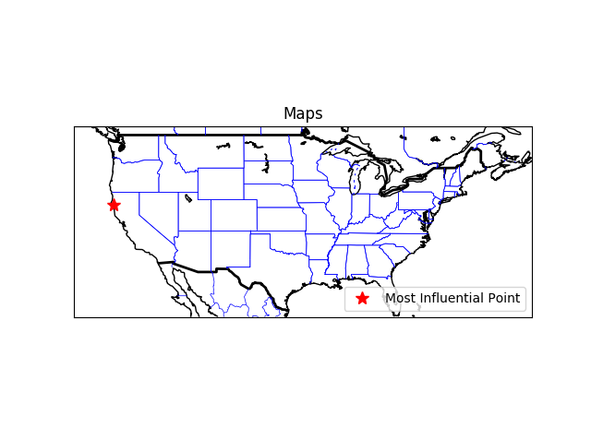
Most Influential Node
Output obtained on Cluster-2:
Plot in world-map :

Slide 34
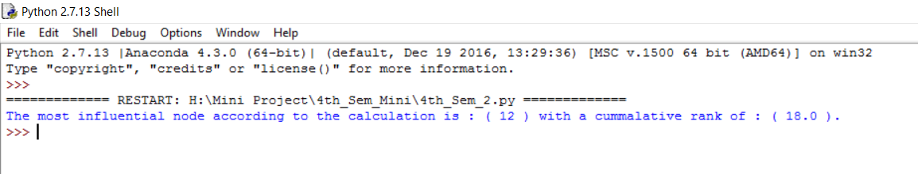
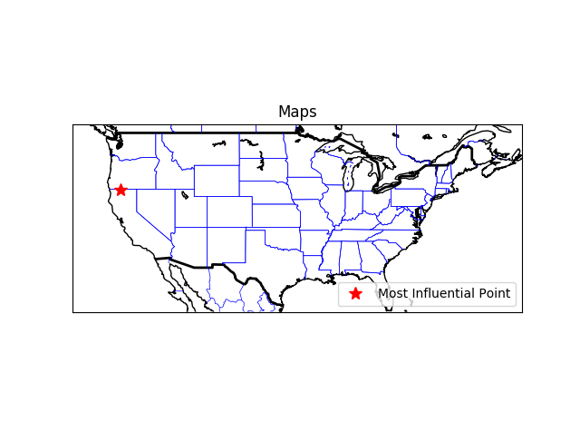
Most Influential Node
Output obtained on Cluster-3:
Plot in world-map :

Slide 35
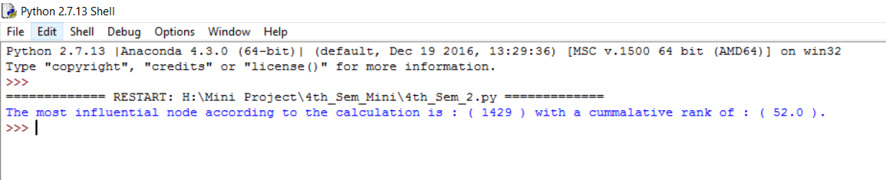

Most Influential Node
Output obtained on Cluster-4:
Plot in world-map :

Slide 36
Statistics
Serial Number | Description | Nodes | Edges
1 | Total dataset | 6104 | 7033
2 | Cluster-1 | 1718 | 1808
3 | Cluster-2 | 1919 | 1877
4 | Cluster-3 | 1438 | 1604
5 | Cluster-4 | 1628 | 1744
Distribution of nodes and edges after using K-Mean clustering algorithm.

Slide 37
Software and Hard-ward Used
Programming Language : Python
Software Platform : Anaconda Python
Library used : ast, numpy, scipy, basemap, mathplotlib, pandas
Hardware : i7 processor, 8GB RAM

Slide 38
Conclusion
Clustering is done because a state is huge in size.
To access a state from one point may lead to delay.
Knowledge of many influential points reduce the dependence of one point so work load can be divided.
The influential score i.e., total aggregate rank of all the points should be comparable to each other so that re-routing of traffic or work load can be easily done if most influential node goes out of order.

Slide 39
Links and References
[1] Amedapu Srinivas, R. Leela Velusamy, “Identification of Influential Nodes from Social Networks based on Enhanced Degree Centrality Measure”, IEEE International Advance Computing Conference, 2015, pp. 1179-1184.
[2] Agnieszka Rusinowska, Rudolf Berghammer, Harrie De Swart, Michel Grabisch, “Social networks: Prestige, centrality, and influence”. in: de Swart. (Ed.) RAMICS 2011, Springer, 2011, pp.22-39
[3]Linton C. Freeman, “Centrality in Social Networks Conceptual Clarification”, Social Networks, vol. 1, Issue 3, 1978–1979, pp. 215-239.
[4] https://www.cs.utah.edu/~lifeifei/SpatialDataset.htm

Slide 40
Thank-You

